Slide 1
Tutorial 1 - UML MODELING

Slide 2
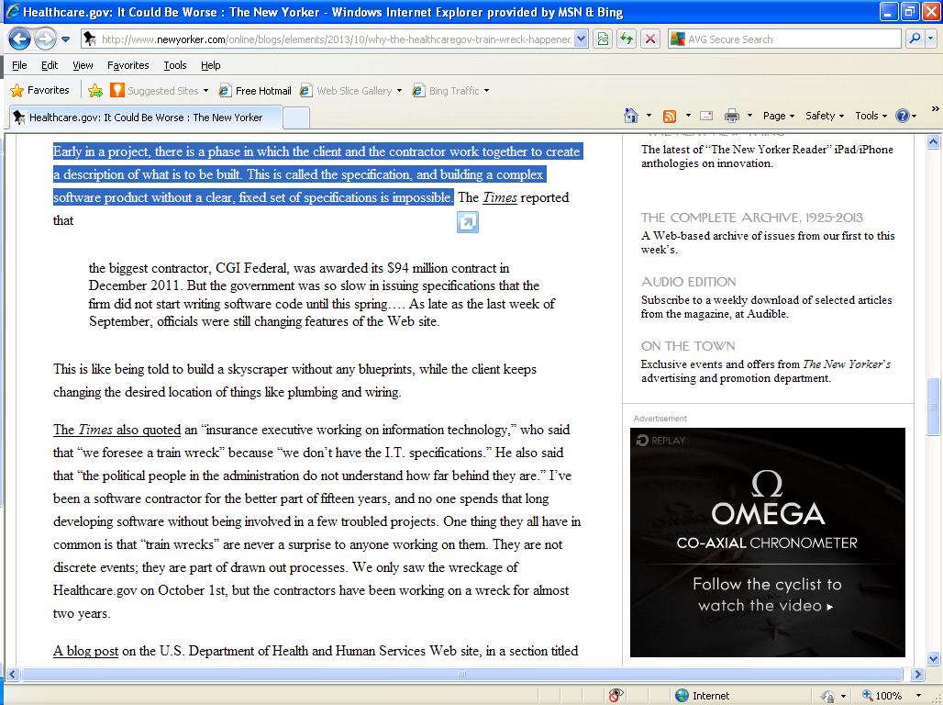
HealthCare.gov October 21, 2013
http://www.newyorker.com/online/blogs/elements/2013/10/why-the-healthcaregov-train-wreck-happened-in-slow-motion.html
UML Modeling

Slide 3
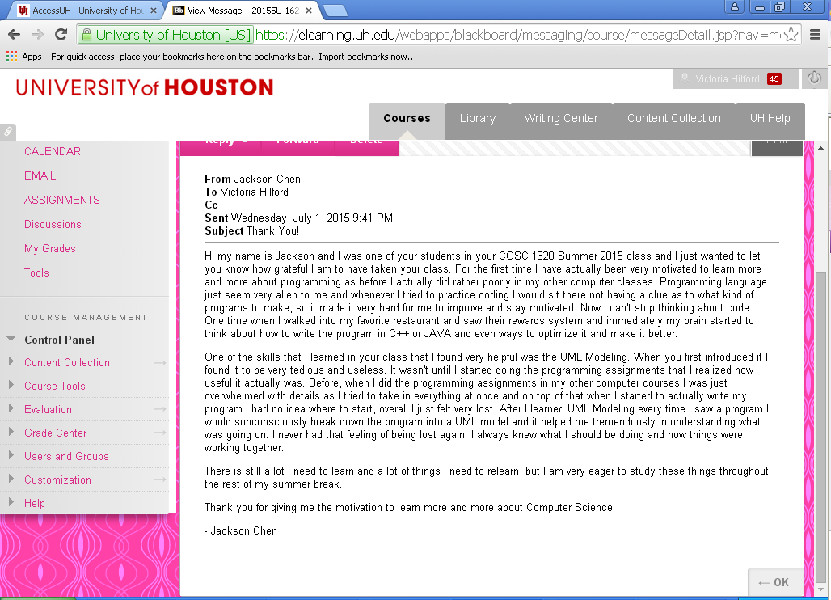

Slide 4
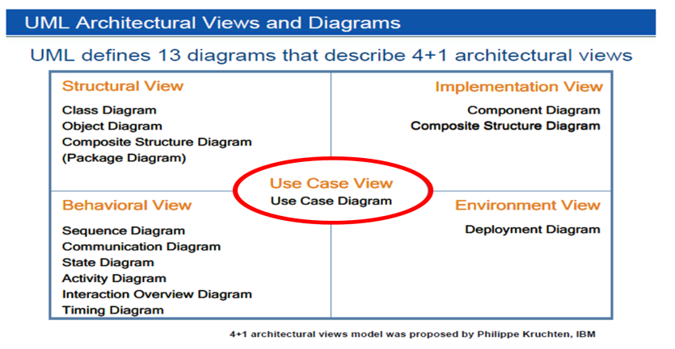
The Unified Modeling Language
The Unified Modeling Language (UML) has become a standard notation for Object Oriented software Analysis (OOA) & Design (OOD – “blue print”)
It is OO Language independent
It includes various types of UML Diagrams (Models) which use specific icons and notations
However, it is flexible – the details you include in a given Diagram (Model) depend on what you are trying to capture and communicate

Slide 5
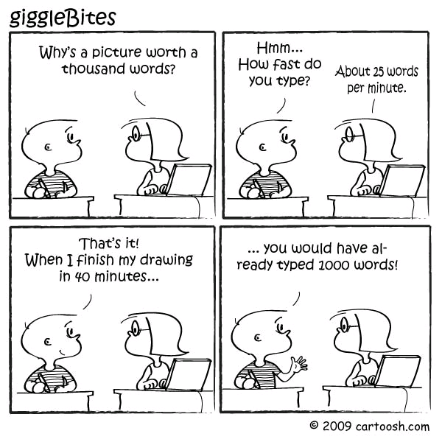
Start with OOA&OOD or Coding?
The heart of Object Oriented Paradigm problem solving is the construction of a Model.
Architects design buildings. Builders use the designs to create buildings.
Blueprints are the standard graphical language that both architects and builders must learn as part of their trade.
Writing software is not unlike constructing a building.
Writing software begins with the construction of a Model. A Model is an abstraction of the underlying problem.
Unified Modeling Language (UML) is a pictorial language used to make software blueprints.
“A picture is worth a thousand words”

Slide 6
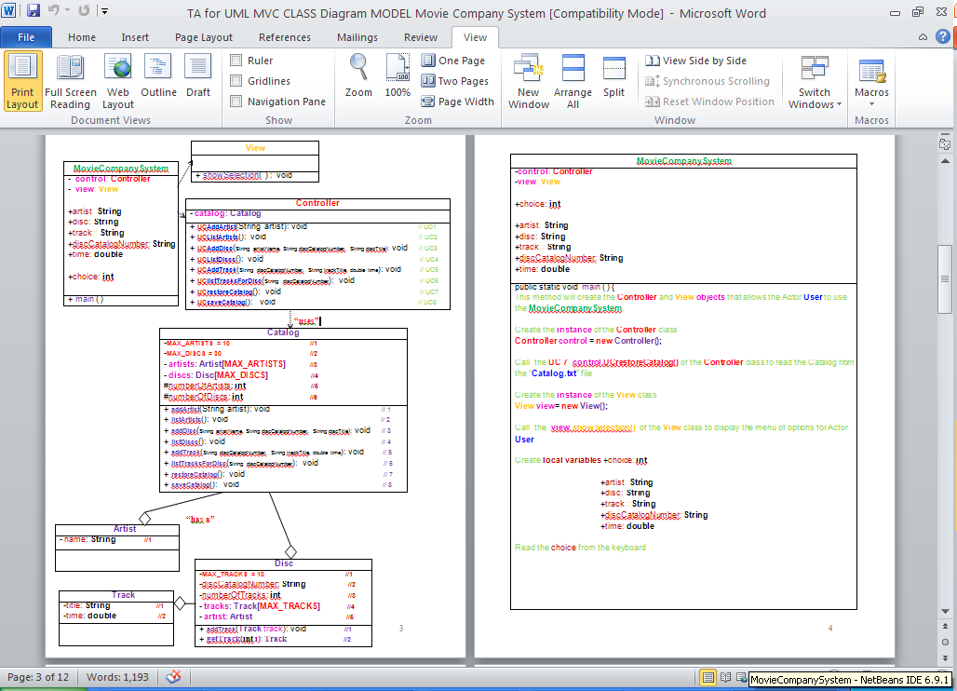
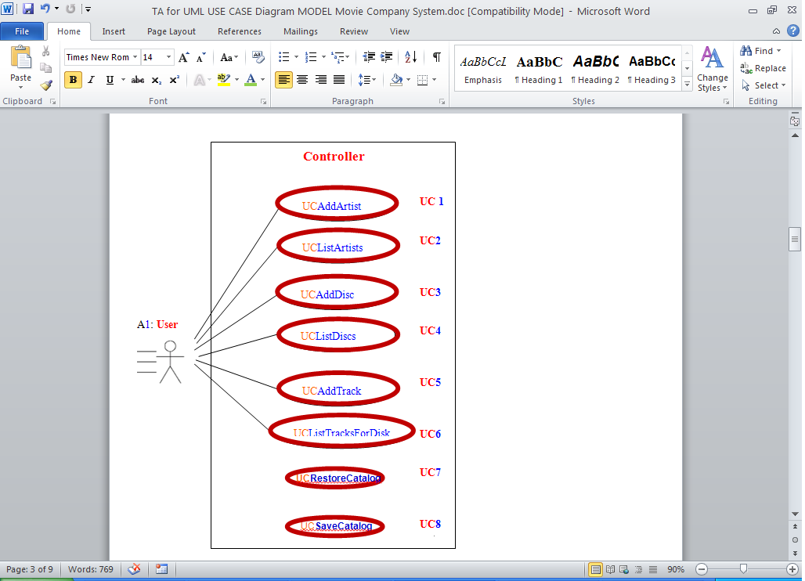
OO Analysis & Design: UML
Unified Modeling Language (UML) is a standardized general purpose Modeling language in the field of Software Engineering.
UML includes a set of graphical notation techniques to create visual Models of software intensive systems.
UML is not a programming language but tools can be used to generate code in various languages using UML Diagrams (Models).
UML has a direct relation with Object Oriented Analysis and Design.

Slide 7
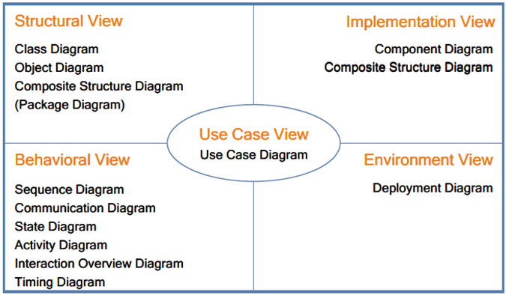
Unified Modeling Language
UML provides structure for problem solving.
A method for Modeling Object Oriented programs.
A means for visualizing, constructing and documenting software projects.
Promotes component Reusability.
You will not understand what your algorithm does two weeks after you wrote it. But if you have the Model, you will catch up fast and easily.
Teamwork for parallel development of large systems.
UML includes 13 Diagrams (Models).

Slide 8
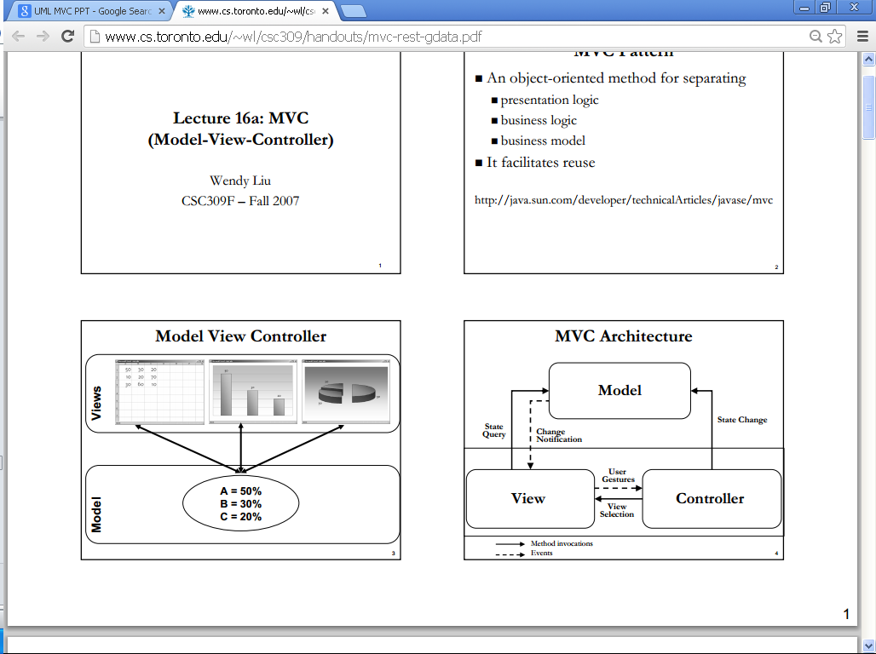
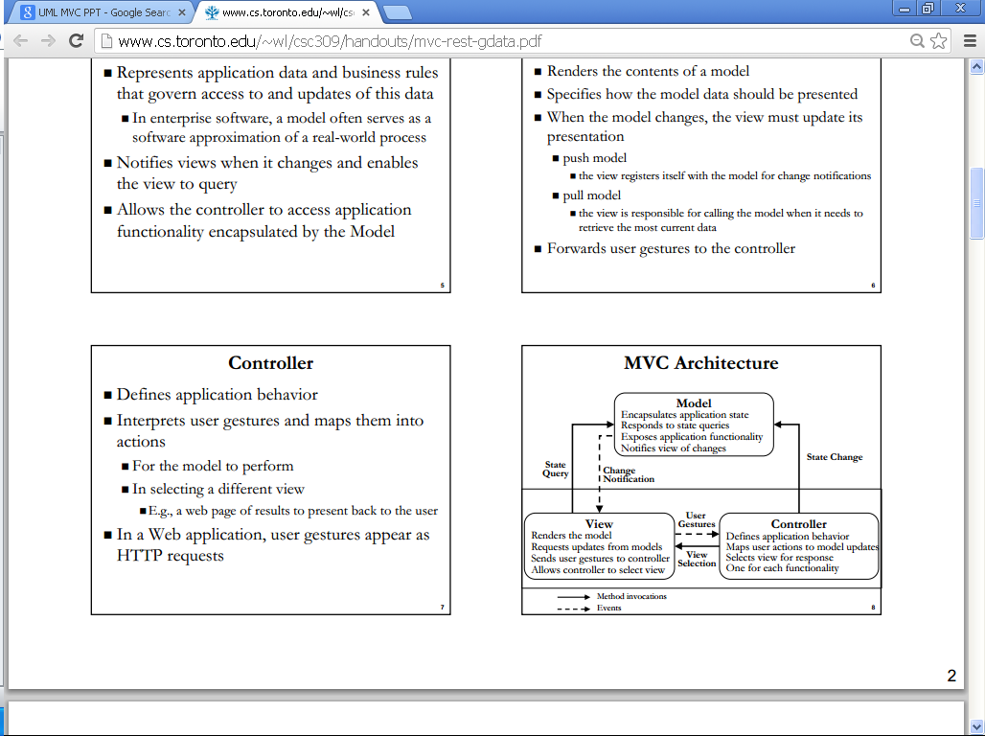
MVC Model View Controller
Design Pattern that separates:
Presentation Logic – View Class
Business Model – Model Class
Business Logic – Controller Class

Slide 9
Unified Modeling Language
UML provides structure for problem solving.
A method for Modeling Object Oriented programs.
A means for visualizing, constructing and documenting software projects.
Promotes component Reusability.
You will not understand what your algorithm does two weeks after you wrote it. But if you have the Model, you will catch up fast and easily.
Teamwork for parallel development of large systems.
UML includes 13 Diagrams (Models).

Slide 10
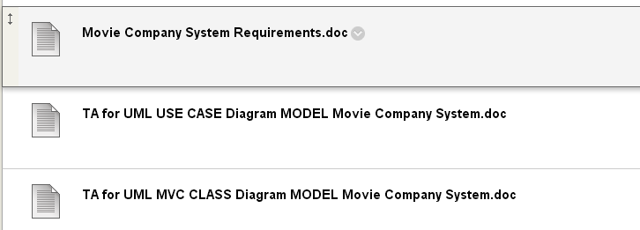
Movie Company System
Case Study
Requirements
Domain/Textual Analysis
UML Modeling

Slide 11
Movie Company System Requirements

Slide 12
Movie Company System Requirements
Close you eyes and “virtually” travel in this world while I read the Requirements

Slide 13
Movie Company System Requirements SAMPLE

Slide 14



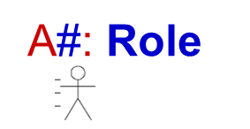


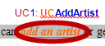


UML USE CASE MODELING
Domain/
CUT & PASTE
REARANGE

Slide 15
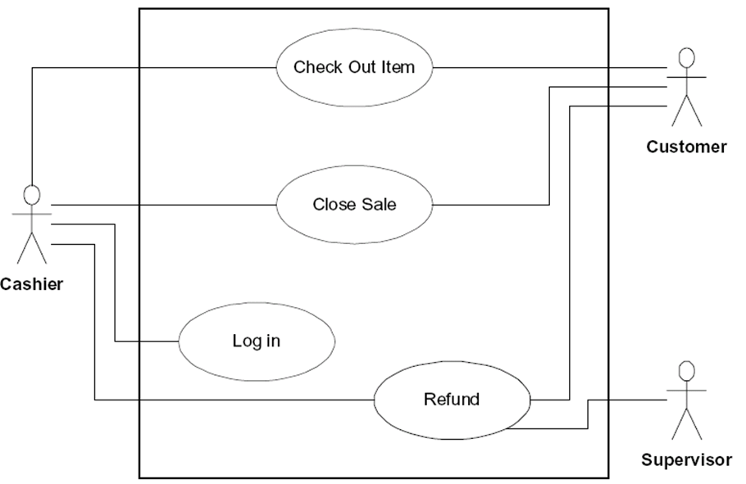
Movie Company System UML USE CASE MODEL
A1: User

Slide 16
Movie Company System UML USE CASE MODEL
A1: User
UC1: UCAddArtist
UC2: UCListArtists
UC3: UCAddDisc
UC4: UCListDiscs
UC5: UCAddTrack
UC6: UCListTracksForDiscs
UC7: UCrestoreCatalog
UC8: UCsaveCatalog

Slide 17
Movie Company System UML USE CASE MODEL - WHAT
CUT & PASTE
A1: User
UC1: UCAddArtist
UC2: UCListArtists
UC3: UCAddDisc
UC4: UCListDiscs
UC5: UCAddTrack
UC6: UCListTracksForDiscs
UC7: restoreCatalog
UC8: saveCatalog

Slide 18
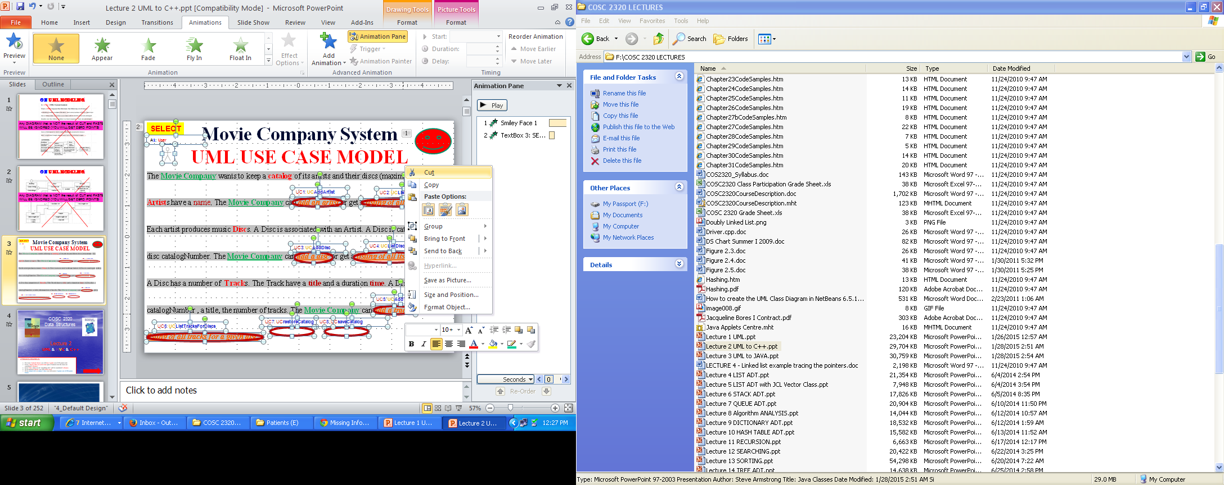

Slide 19
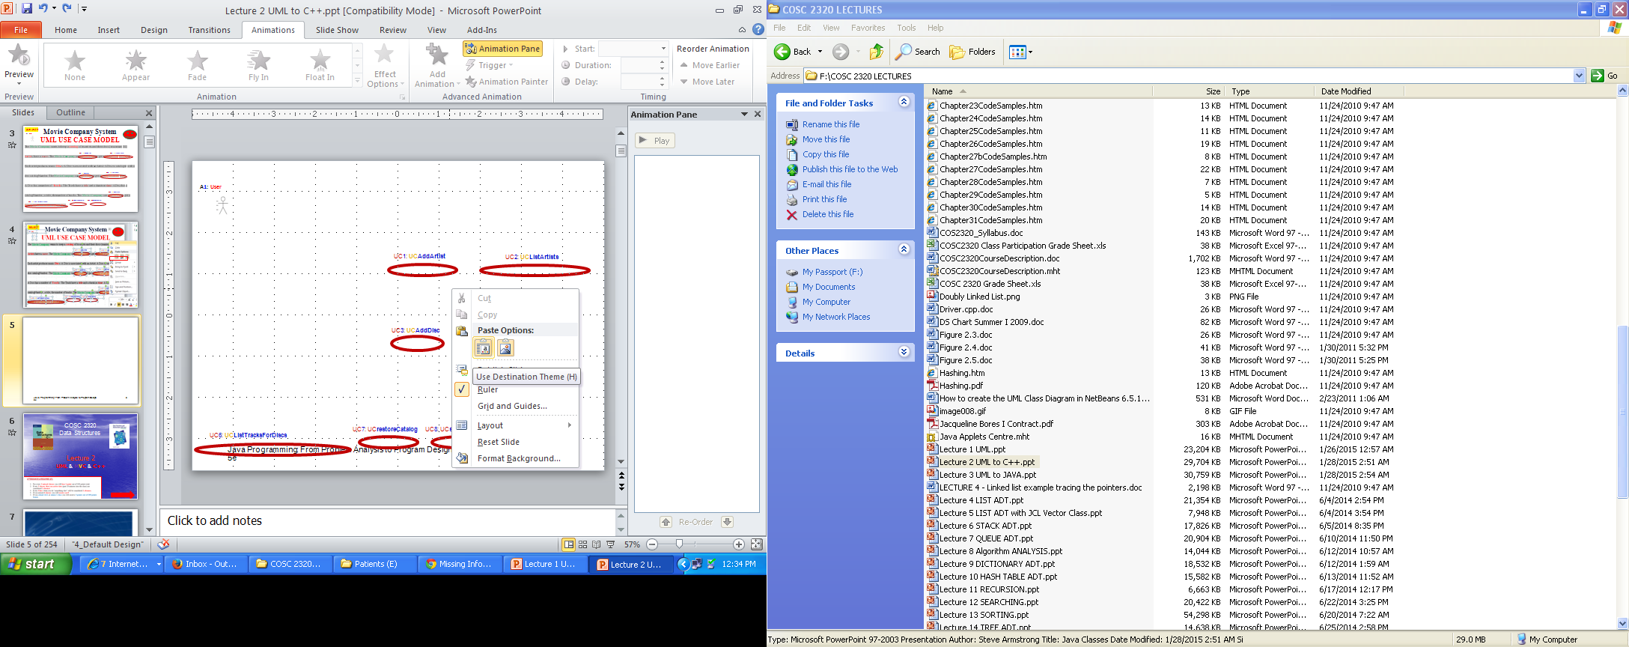

Slide 20
Your deliverable will contain Steps 1 and 2 on one page like this
A1: User
CUT & PASTE
REARANGE
UC1: UCAddArtist
UC2: UCListArtists
UC3: UCAddDisc
UC4: UCListDiscs
UC5: UCAddTrack
UC6: UCListTracksForDiscs
UC7: restoreCatalog
UC8: saveCatalog

Slide 21
Movie Company System UML USE CASE MODEL
REARRANGE
Controller
: UCAddArtist UC1
: UCListArtists UC2
: UCAddDisc UC3
UCListDiscs UC4
A1: User
: UCAddTrack UC5
: UCListTracksForDiscs UC6
: UCrestoreCatalog UC7
: UCsaveCatalog UC8

Slide 22
Movie Company System UML USE CASE MODEL
Controller
: UCAddArtist UC1
: UCListArtists UC2
: UCAddDisc UC3
Any DIAGRAM that is NOT the result of CUT and PASTE
WILL BE IGNORED (YOU WILL GET ZERO POINTS)
UCListDiscs UC4
A1: User
: UCAddTrack UC5
: UCListTracksForDiscs UC6
: UCrestoreCatalog UC7
: UCsaveCatalog UC8

Slide 23
Movie Company System UML USE CASE Description
UC1 UCAddArtist Description
Name: | UCAddArtist
Actor: | User
Description: | This use case describes the process used by User to Add another Artist
Successful Completion: | User requests Adding Artist by artistName Movie Company System checks to see if not already there and there is room in the artists array Artist with artistName is added at the end of the artists array and successful message is sent to the User
Alternative: | User requests Adding Artist by artistName Movie Company System checks to see if not already in the artists array and there is no room If artistName either ALREADY present or NO MORE ROOM MAX_ARTISTS Artist with artistName is NOT added and UNsuccessful message is sent to the User
Pre-Condition: | User requests Add Artist
Post-Condition: | Artist with artistName Added successfully or UNsuccessfully
Assumptions: | None

Slide 24
Movie Company System UML USE CASE Description
UC2 UCListArtists Description
Name: | UCListArtists
Actor: | User
Description: | This use case describes the process used by User to List all Artists
Successful Completion: | User requests Listing Artists Movie Company System displays all the Artists by traversing the artists array
Alternative:
Pre-Condition: | User requests List Artists
Post-Condition: | Artists displayed
Assumptions: | None

Slide 25
Movie Company System UML USE CASE Description
UC3 UCAddDisc Description
Name: | UCAddDisc
Actor: | User
Description: | This use case describes the process used by User to Add another Disc for a particular artistName
Successful Completion: | User requests Adding Disc to artistName Movie Company System prompts for discCatalogNumber Movie Company System prompts for disc Disc discCatalogNumber , disc is Added to the disks array and successful message is sent to the User
Alternative: | User requests Adding Disc to artistName Movie Company System prompts for discCatalogNumber Movie Company System prompts for disc Movie Company System checks to see if not already the disks array and there is room in the disks array If disc either ALREADY present or NO MORE ROOM MAX_DISCS Disc disc is NOT added and UNsuccessful message is sent to the User
Pre-Condition: | User requests Add Disc
Post-Condition: | Disc discCatalogNumber, disc Added to the disks array successfully or UNsuccessfully
Assumptions: | None

Slide 26
Movie Company System UML USE CASE Description
UC4 UCListDiscs Description
Name: | UCListDiscs
Actor: | User
Description: | This use case describes the process used by User to List all Discs
Successful Completion: | User requests Listing Discs Movie Company System displays all the Discs in the disks array, discCatalogNumber, title, artistName
Alternative:
Pre-Condition: | User requests List Discs
Post-Condition: | Discs displayed
Assumptions: | None

Slide 27
Movie Company System UML USE CASE Description
UC5 UCAddTrack Description
Name: | UCAddTrack
Actor: | User
Description: | This use case describes the process used by User to Add another Track trackTitle, time for a particular discCatalogNumber
Successful Completion: | User requests Adding Track to Disc discCatalogNumber Movie Company System prompts for trackTitle Movie Company System prompts for time Track trackTitle, time is Added to Disc discCatalogNumber and successful message is sent to the User
Alternative: | User requests Adding Track to Disc discCatalogNumber Movie Company System prompts for trackTitle Movie Company System prompts for time Movie Company System checks to see if not already there and there is room If trackTitle either ALREADY present or NO MORE ROOM MAX_TRACKS Track trackTitle is NOT added and UNsuccessful message is sent to the User
Pre-Condition: | User requests Add Track
Post-Condition: | Track trackTitle, time Added to Disc discCatalogNumber successfully or UNsuccessfully
Assumptions: | None

Slide 28
Movie Company System UML USE CASE Description
UC6 UCListTracksForDisc Description
Name: | UCListTracksForDisc
Actor: | User
Description: | This use case describes the process used by User to List all Tracks title for a Disc discCatalogNumber
Successful Completion: | User requests Listing Discs Movie Company System displays all the Tracks title for Disc discCatalogNumber
Alternative:
Pre-Condition: | User requests List Tracks for Disc
Post-Condition: | Tracks for Disc displayed
Assumptions: | None

Slide 29
Movie Company System UML USE CASE Description
UC7 UCRestoreCatalog Description
Name: | UCRestoreCatalog
Actor: | None
Description: | This use case describes the process of reading the catalog from a data file (Input). It is called automatically when the Movie Company System starts running
Successful Completion: | Opens “Catalog.txt” file and reads the catalog
Alternative:
Pre-Condition: | None
Post-Condition: | The catalog resides in the Movie Company System memory.
Assumptions: | File “Catalog.txt” was read successfully

Slide 30
Movie Company System UML USE CASE Description
UC8 UCSaveCatalog Description
Name: | UCSaveCatalog
Actor: | None
Description: | This use case describes the process of writing the catalog from Movie Company System memory to data file “Catalog.txt” (Output). It is called automatically before the Movie Company System exits
Successful Completion: | Opens “Catalog.txt” file and write the catalog
Alternative:
Pre-Condition: | The catalog resides in the Movie Company System memory.
Post-Condition: | The catalog resides in the “Catalog.txt” file.
Assumptions: | File “Catalog.txt” was opened for write successfully
Completed UML USE CASE MODEL
WOW!

Slide 31
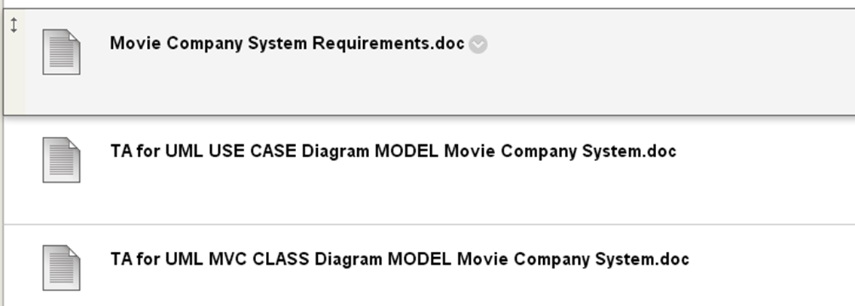
Movie Company System UML USE CASE MODEL
Please use TEMPLATE
“TA for UML USE CASE Diagram MODEL Movie Company System.doc “
80% REUSABLE.

Slide 32
Movie Company System UML USE CASE MODEL
Complete example.

Slide 33
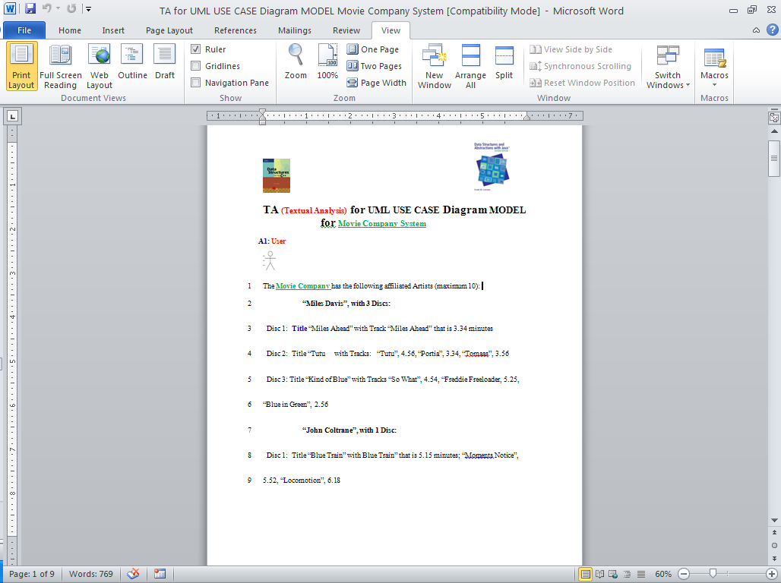
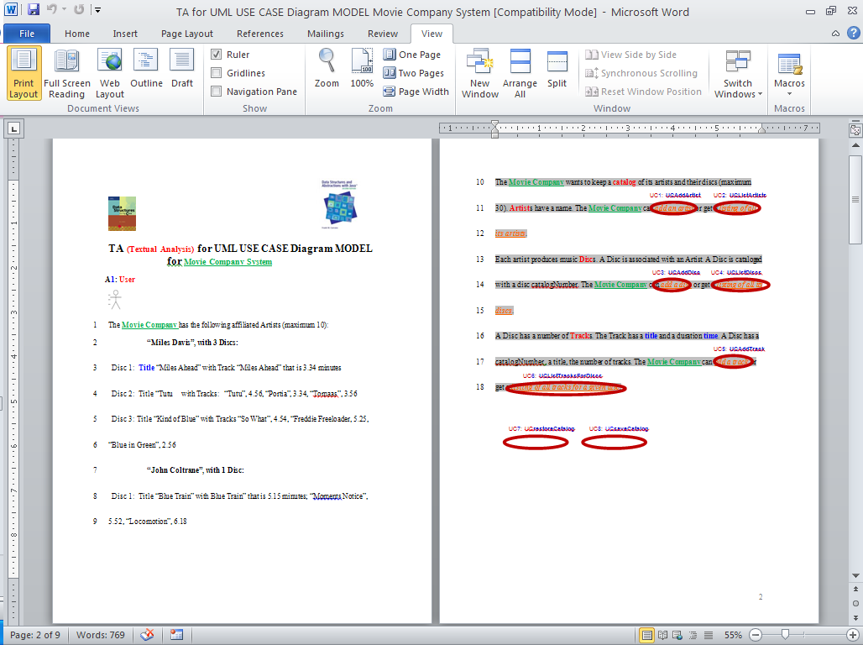
All steps on one Requirements document!

Slide 34
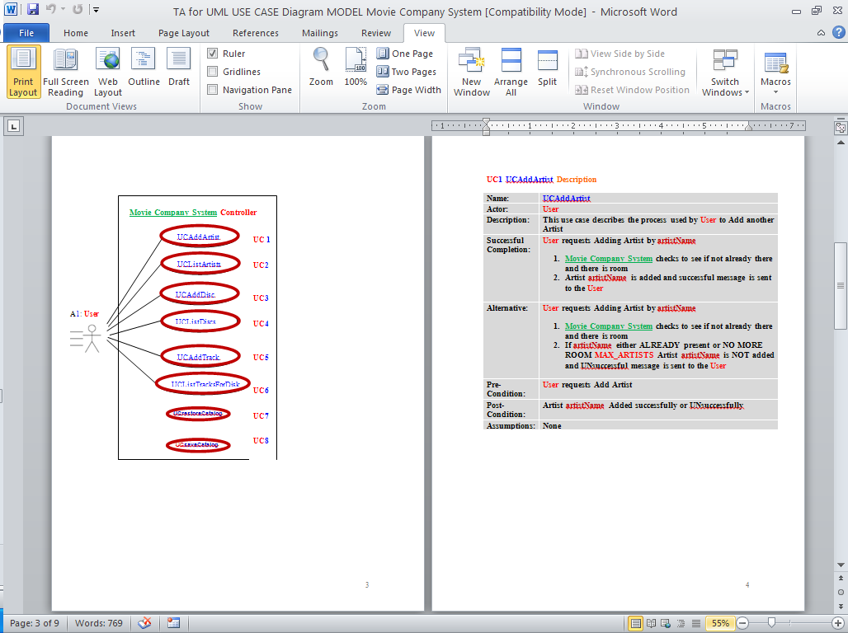
AND SO ON!

Slide 35
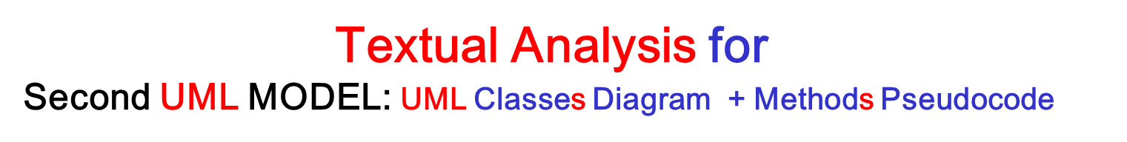


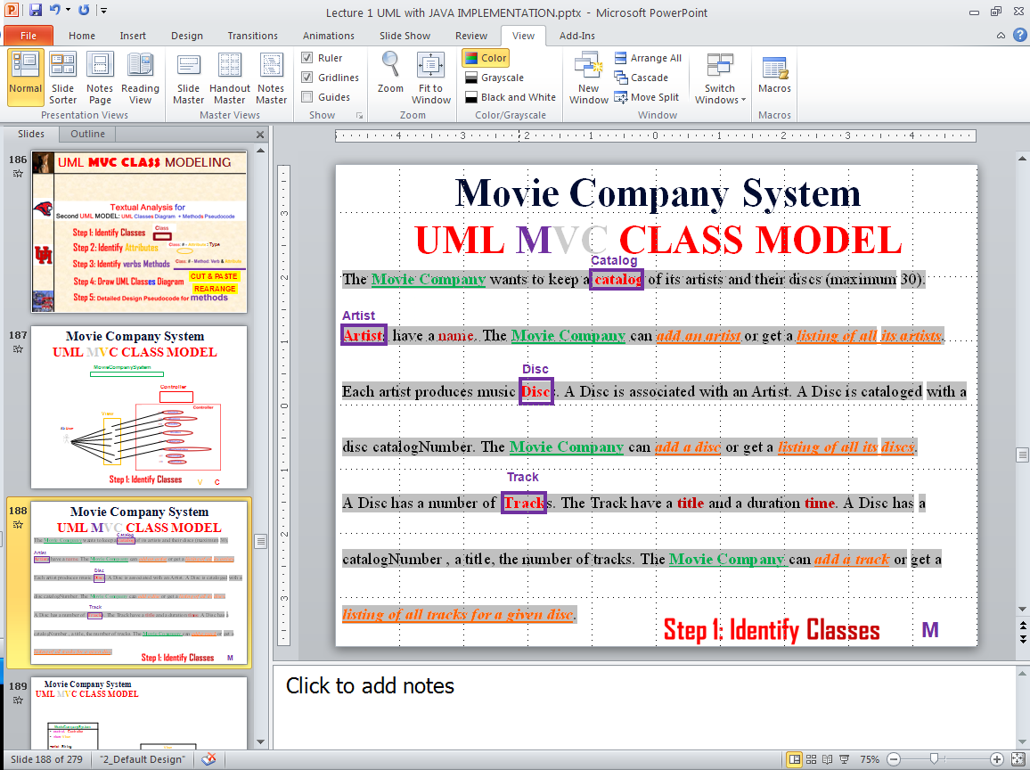


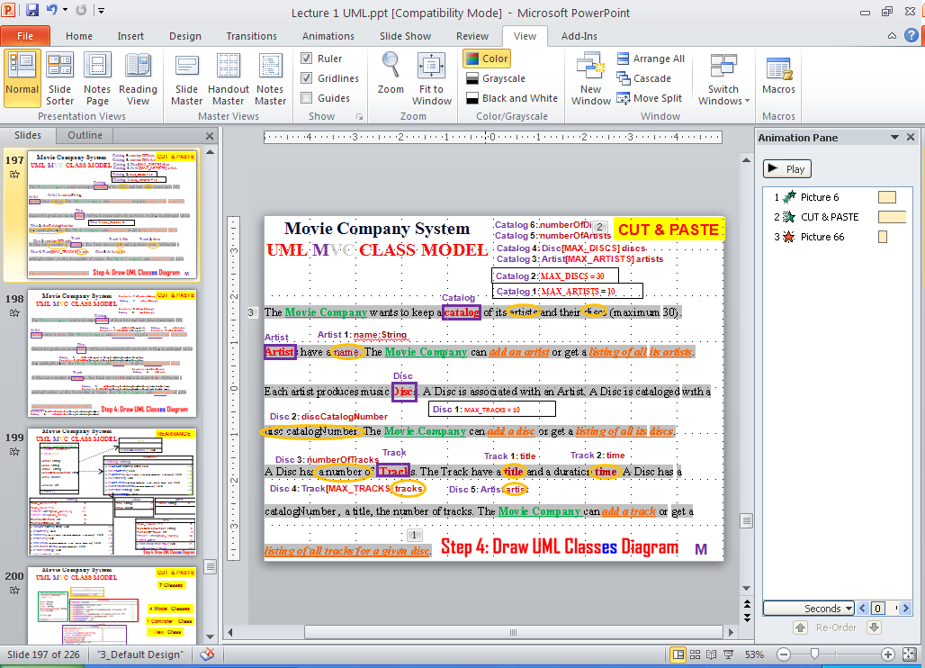
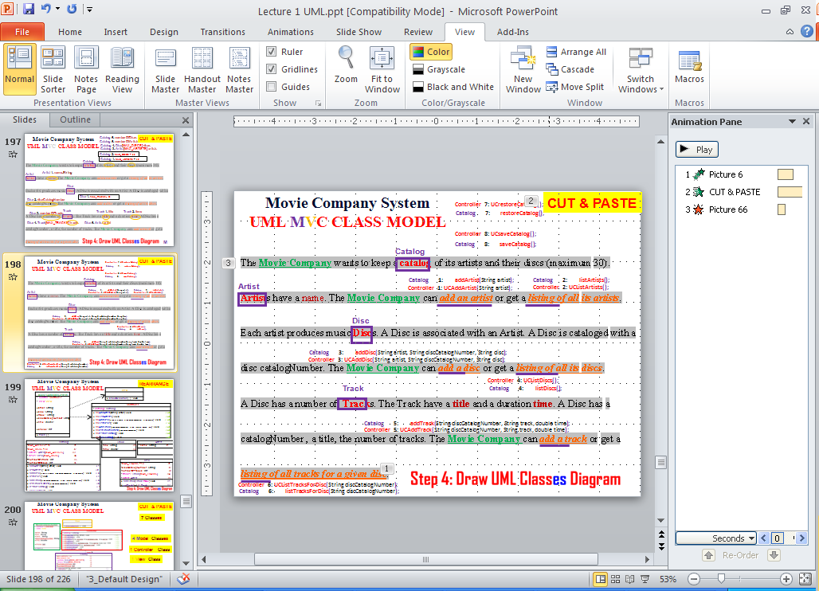




UML MVC CLASS MODELING
Domain/
: Type
CUT & PASTE
REARANGE

Slide 36
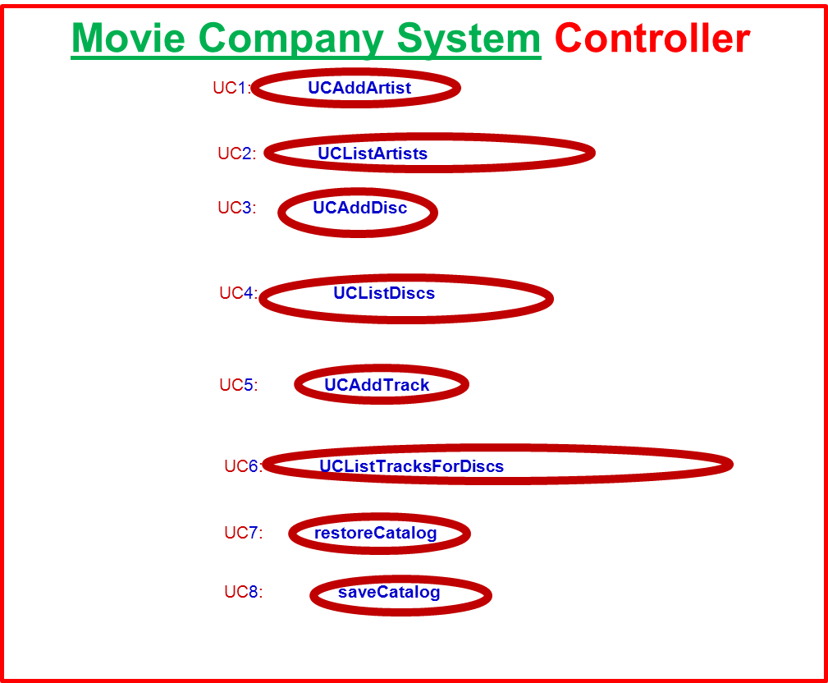
Movie Company System UML MVC CLASS MODEL
MovieCompanySystem
Controller
View
A1: User
V
C

Slide 37
Movie Company System UML MVC CLASS MODEL
Catalog
Artist
Disc
Track
M

Slide 38
Movie Company System UML MVC CLASS MODEL
MovieCompanySystem
- control: Controller - view: View +artist: String +disc: String +track:: String +discCatalogNumber: String +time: double +choice: int
View
Controller
- catalog: Catalog
V
C

Slide 39
Movie Company System UML MVC CLASS MODEL
Catalog 6: numberOfDiscs : int
Catalog 5: numberOfArtists : Int
Catalog 4: Disc[MAX_DISCS] discs
Catalog 3: Artist[MAX_ARTISTS] artists
Catalog 2: MAX_DISCS = 30
Catalog
Catalog 1: MAX_ARTISTS = 10
Artist
Artist 1: name : String
Disc
Disc 1: MAX_TRACKS = 10
Disc 2: discCatalogNumber : String
Disc 3: numberOfTracks : int
Track
Track 1: title : String
Track 2: time : double
Disc 4: Track[MAX_TRACKS] tracks
Disc 5: Artist artist
M

Slide 40
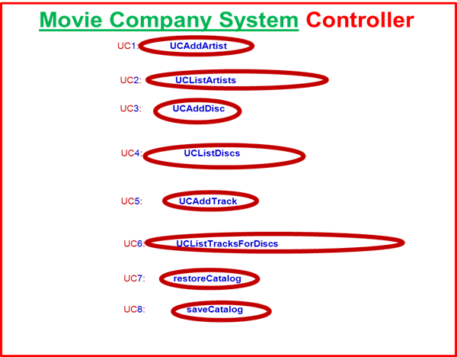
Movie Company System UML MVC CLASS MODEL
MovieCompanySystem
- control: Controller - view: View +artist: String +disc: String +track:: String +discCatalogNumber: String +time: double +choice: int
+ main ( )
View
+ showSelection( ) : void
Controller
- catalog: Catalog
+ UCAddArtist(String artist): void // UC1 + UCListArtists(): void // UC2 + UCAddDisc(String artistName, String discCatalogNumber, String discTitle): void // UC3 + UCListDiscs(): void // UC4 + UCAddTrack(String discCatalogNumber, String trackTitle, double time): void // UC5 + UClistTracksForDisc(String discCatalogNumber): void // UC6 + UCrestoreCatalog(): void // UC7 + UCsaveCatalog(): void // UC8
V
C

Slide 41
Movie Company System UML MVC CLASS MODEL
Catalog
Artist
Catalog 1: addArtist(String artist);
Catalog 2: listArtists();
Controller 1: UCAddArtist(String artist);
Controller 2: UCListArtists();
Disc
Catalog 3: addDisc(String artist, String discCatalogNumber, String disc);
Controller 3: UCAddDisc(String artist, String discCatalogNumber, String disc);
Controller 4: UCListDiscs();
Track
Catalog 4: listDiscs();
Catalog 5: addTrack(String discCatalogNumber, String track, double time);
Controller 5: UCAddTrack(String discCatalogNumber, String track, double time);
Controller 7: UCrestoreCatalog();
Controller 8: UCsaveCatalog();
Catalog 8: saveCatalog();
Catalog 7: restoreCatalog();
Controller 6: UCListTracksForDisc(String discCatalogNumber);
M
Catalog 6: listTracksForDisc(String discCatalogNumber);

Slide 42
Movie Company System UML MVC CLASS MODEL
Catalog 6: numberOfDiscs
CUT & PASTE
Catalog 5: numberOfArtists
Catalog 4: Disc[MAX_DISCS] discs
Catalog 3: Artist[MAX_ARTISTS] artists
Catalog 2: MAX_DISCS = 30
Catalog
Catalog 1: MAX_ARTISTS = 10
Artist
Artist 1: name
Disc
Disc 1: MAX_TRACKS = 10
Disc 2: discCatalogNumber
Track
Track 1: title
Track 2: time
Disc 3: numberOfTracks
Disc 4: Track[MAX_TRACKS] tracks
Disc 5: Artist artist
M

Slide 43
Movie Company System UML MVC CLASS MODEL
CUT & PASTE
Catalog
Artist
Catalog 1: addArtist(String artist);
Catalog 2: listArtists();
Controller 1: UCAddArtist(String artist);
Controller 2: UCListArtists();
Disc
Catalog 3: addDisc(String artist, String discCatalogNumber, String disc);
Controller 3: UCAddDisc(String artist, String discCatalogNumber, String disc);
Controller 4: UCListDiscs();
Track
Catalog 4: listDiscs();
Catalog 5: addTrack(String discCatalogNumber, String track, double time);
Controller 5: UCAddTrack(String discCatalogNumber, String track, double time);
Controller 8: UCsaveCatalog();
Controller 7: UCrestoreCatalog();
Catalog 8: saveCatalog();
Catalog 7: restoreCatalog();
Controller 6: UCListTracksForDisc(String discCatalogNumber);
Catalog 6: listTracksForDisc(String discCatalogNumber);

Slide 44
Movie Company System UML MVC CLASS MODEL
REARRANGE
View
+ showSelection( ) : void
MovieCompanySystem
- control: Controller - view: View +artist: String +disc: String +track:: String +discCatalogNumber: String +time: double +choice: int
+ main ( )
Controller
- catalog: Catalog
+ UCAddArtist(String artist): void // UC1 + UCListArtists(): void // UC2 + UCAddDisc(String artistName, String discCatalogNumber, String discTitle): void // UC3 + UCListDiscs(): void // UC4 + UCAddTrack(String discCatalogNumber, String trackTitle, double time): void // UC5 + UClistTracksForDisc(String discCatalogNumber): void // UC6 + UCrestoreCatalog(): void // UC7 + UCsaveCatalog(): void // UC8
Any DIAGRAM that is NOT the result of CUT and PASTE
WILL BE IGNORED (YOU WILL GET ZERO POINTS)
Catalog
-MAX_ARTISTS = 10 //1 -MAX_DISCS = 30 //2 - artists: Artist[MAX_ARTISTS] //3 - discs: Disc[MAX_DISCS] //4 #numberOfArtists: int //5 #numberOfDiscs: int //6
+ addArtist(String artist): void // 1 + listArtists(): void // 2 + addDisc(String artistName, String discCatalogNumber, String discTitle): void // 3 + listDiscs(): void // 4 + addTrack(String discCatalogNumber, String trackTitle, double time): void // 5 + listTracksForDisc(String discCatalogNumber): void // 6 + restoreCatalog(): void // 7 + saveCatalog(): void // 8
Track
-title: String //1 -time: double //2
Artist
- name: String //1
Disc
-MAX_TRACKS = 10 //1 -discCatalogNumber: String //2 -numberOfTracks: int //3 - tracks: Track[MAX_TRACKS] //4 - artist: Artist //5
+ addTrack(Track track): void //1 + getTrack(int i): Track //2

Slide 45
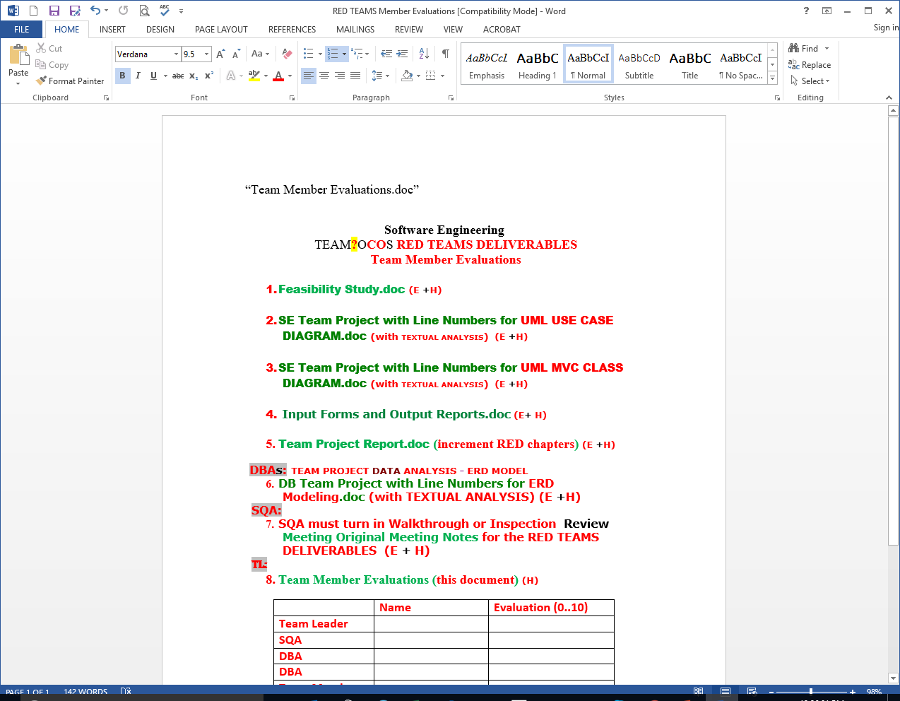
Movie Company System UML MVC CLASS MODEL
CUT & PASTE
7 Classes
HTML
4 Model Classes
1 Controller Class
DATABASE back end TABLES will become your MODELS in the front end.
1 View Class
1 Appl Class
OOA ends here

Slide 46
Movie Company System UML MVC CLASS MODEL
7 Classes
OOD starts here

Slide 47
Movie Company System UML MVC CLASS MODEL
MovieCompanySystem
-control: Controller -view: View +choice: int +artist: String +disc: String +track:: String +discCatalogNumber: String +time: double
public static void main ( ) { This method will create the Controller and View objects that allows the Actor User to use the MovieCompanySystem. Create the instance of the Controller class Controller control = new Controller(); Call the UC 7 control.UCrestoreCatalog() of the Controller class to read the Catalog from the “Catalog.txt” file Create the instance of the View class View view= new View(); Call the view.showSelection() of the View class to display the menu of options for Actor User Create local variables +choice: int +artist: String +disc: String +track:: String +discCatalogNumber: String +time: double Read the choice from the keyboard

Slide 48
Movie Company System UML MVC CLASS MODEL
MovieCompanySystem
-control: Controller -view: View +choice: int +artist: String +disc: String +track:: String +discCatalogNumber: String +time: double
Case choice of 1: Prompt for Artist Name artist Call the Controller method UC1 control.UCAddArtist(artist); 2: Call the Controller method UC2 control.UCListArtist(); 3: Prompt for Artist Name artist Prompt for Disc Catalog Number Name discCatalogNumber Prompt for Disc Name disc Call the Controller method UC3 control.UCAddDisc(artist,discCatalogNumber,disc); 4: Call the Controller method UC4 control.UCListDiscs(); 5: Prompt for Artist Name artist Prompt for Disc Catalog Number Name discCatalogNumber Prompt for Disc Name disc Call the Controller method UC5 control.UCAddDisc(artist,discCatalogNumber,disc); 6: Prompt for Disc Catalog Number Name discCatalogNumber Call the Controller method UC6 control.UCListTracksForDisc(discCatalogNumber); Call the UC 8 control.UCsaveCatalog() of the Controller class to write the Catalog in the “Catalog.txt” file }

Slide 49
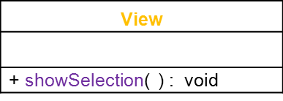
Movie Company System UML MVC CLASS MODEL
public void showSelection( ) {
Display the string “Welcome the Movie Company System”
Display the string “Enter 1 for adding Artist:”
Display the string “Enter 2 for listing Artists:”
Display the string “Enter 3 for adding Disc:”
Display the string “Enter 4 for listing Discs:”
Display the string “Enter 5 for adding Track for Disc:”
Display the string “Enter 6 for listing Tracks for Disc:”
}

Slide 50
Movie Company System UML MVC CLASS MODEL
- catalog: Catalog
Create the instance of the Catalog class
Catalog catalog = new Catalog();
Since the catalog is private we need to call a public method in the catalog to
operate on the private instance variables of the catalog
public void UCAddArtist(String artist){
catalog.addArtist(artist);
} // UC1
public void UCListArtists(){
catalog.listArtists();
} // UC2
public void UCAddDisc(String artistName, String discCatalogNumber, String discTitle){
catalog.addDisc(artistName, discCatalogNumber, discTitle);
}
// UC3
public void UCListDiscs(){
catalog.listDiscs();
}
// UC4
public void UCAddTrack(String discCatalogNumber, String trackTitle, double time){
catalog.addTrack(discCatalogNumber, trackTitle, time);
} // UC5
public void UClistTracksForDisc(String discCatalogNumber){
catalog.listTracksForDisc(discCatalogNumber);
}
// UC6
public void UCrestoreCatalog(){
catalog.restoreCatalog();
}
// UC7
public void UCsaveCatalog(){
catalog.saveCatalog();
}
Controller
- catalog: Catalog
+ UCAddArtist(String artist): void // UC1 + UCListArtists(): void // UC2 + UCAddDisc(String artistName, String discCatalogNumber, String discTitle): void // UC3 + UCListDiscs(): void // UC4 + UCAddTrack(String discCatalogNumber, String trackTitle, double time): void // UC5 + UClistTracksForDisc(String discCatalogNumber): void // UC6 + UCrestoreCatalog(): void // UC7 + UCsaveCatalog(): void // UC8
OOD – “blue print” DONE!
AND so ON…
Can run software on PAPER!

Slide 51
Movie Company System UML MVC CLASS MODEL
Please use TEMPLATE
“TA for UML MVC CLASS Diagram MODEL Movie Company System.doc “
80% REUSABLE.

Slide 52
Movie Company System UML MVC CLASS MODEL
Complete example.

Slide 53
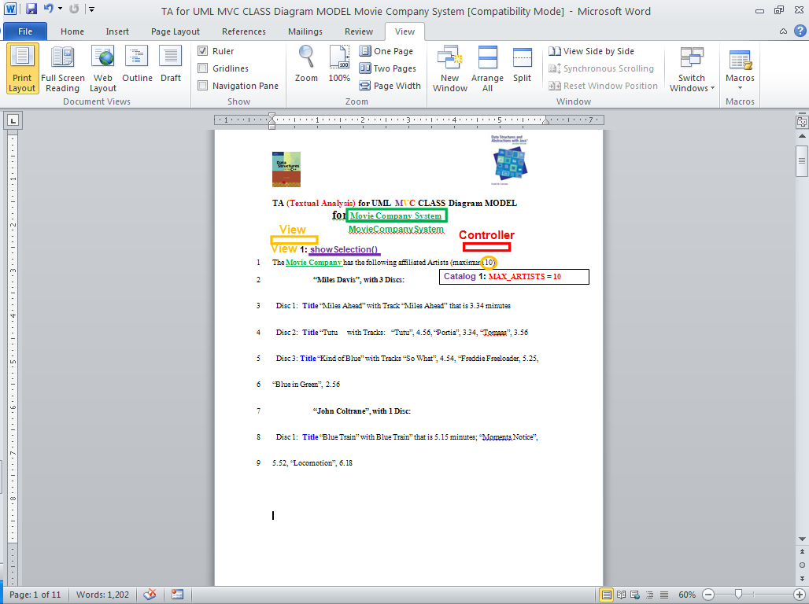
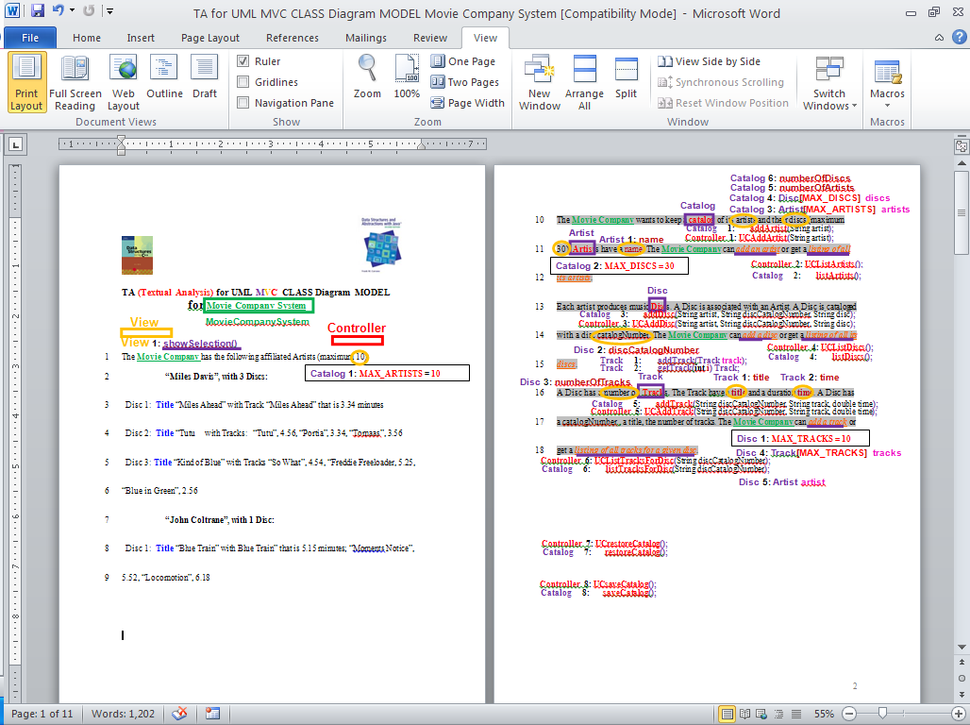
All steps on one Requirements document!

Slide 54
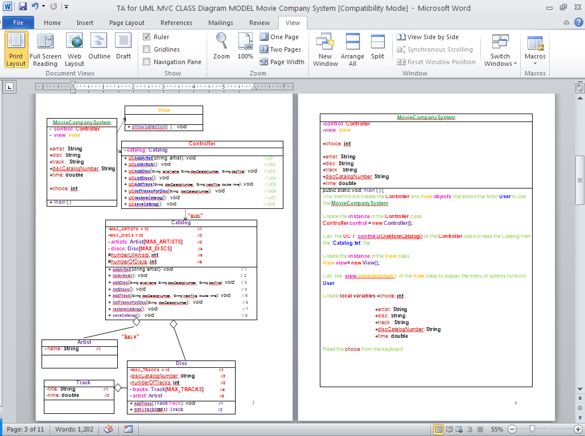
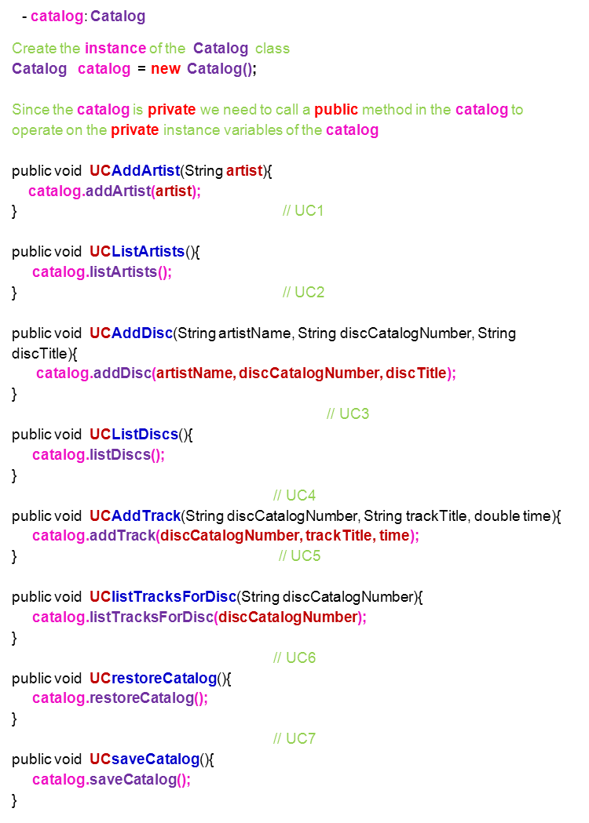
AND SO ON!

Slide 55
I love UML!
The End

